Slide 1
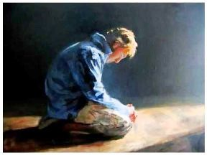
In Need

Slide 2
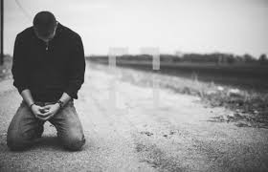
In Need
Of Grace
Because of Wrath

Slide 3
In Need
Of Love
Because of Justice of God

Slide 4
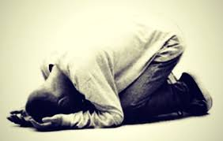
In Need
Of Mercy
Because Of Sin

Slide 5
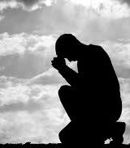
In Need
Of Strength
Because of Weakness

Slide 6
In Need
Of Peace
Because of Turmoil

Slide 7
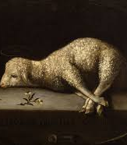
In Need
Of Christ
The Perfect Lamb
The Great I Am

Slide 8
MY HUMBLE PLEA
I Am Your Child
In Need

