Slide 1
Parable of the Loving Father
Luke 15:11-24

Slide 2
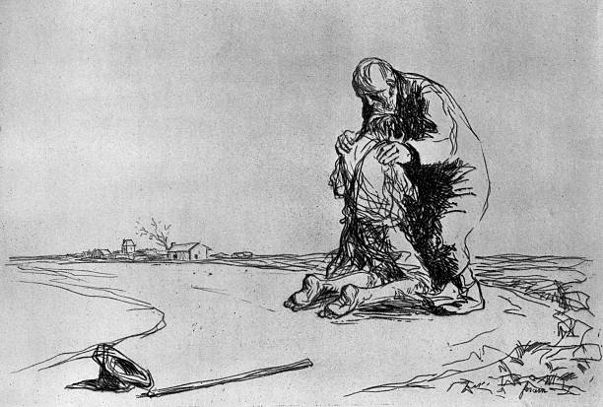
1. Freedom To Leave
Luke 15:11-13
Genesis 2:16-17
Matthew 12:30
John 14:15

Slide 3
2. Folly of Sin
Luke 15:14-16
Isaiah 59:1-2
1 Peter 3:12
Romans 6:23

Slide 4
3. Forgiveness To Come Home
Luke 15:17-24
Romans 5:6-8
John 3:16
John 15:13-14

Slide 5
It’s Not Too Late To Come Home
Decide To Be Baptized Today
Hear Him (Romans 10:17)
Believe Him (Mark 16:16)
Repent Of Sins Against Him (Acts 2:38)
Confess Him (Acts 8:37)
Be Baptized Into Him (John 3:5; Acts 22:16)
Live For Him (Galatians 2:20)
Decide To Be Restored Today
Come Back To Him (Matthew 11:28-30)
Repent (Acts 8:22)
Pray (James 5:16)

