Slide 1
WELCOME TO OUR SERVICES
TONIGHT’S SERMON:
BURIED TREASURE

Slide 2
“Again, the kingdom of heaven is like treasure hidden in a field, which a man found and hid; and for joy over it he goes and sells all that he has and buys that field. “Again, the kingdom of heaven is like a merchant seeking beautiful pearls, who, when he had found one pearl of great price, went and sold all that he had and bought it. – Mt. 13:44-45
In one parable a person finds something (whether he was searching or not) and in the other parable a person is seeking something.
In both parables the individual realizes the value of what he has found.
The kingdom parables of Jesus usually describe the church and various aspects of her.

Slide 3
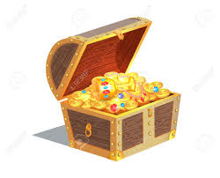
THE TREASURE
For this is he of whom it is written:
‘Behold, I send My messenger before Your face, Who will prepare Your way before You.’
“Assuredly, I say to you, among those born of women there has not risen one greater than John the Baptist; but he who is least in the kingdom of heaven is greater than he.” – Matthew 11:10-11

Slide 4
THE SACRIFICE
Then Jesus said to His disciples, “If anyone desires to come after Me, let him deny himself, and take up his cross, and follow Me. For whoever desires to save his life will lose it, but whoever loses his life for My sake will find it. For what profit is it to a man if he gains the whole world, and loses his own soul? Or what will a man give in exchange for his soul? – Matthew 16:24-26

Slide 5
THE JOY
But what things were gain to me, these I have counted loss for Christ. Yet indeed I also count all things loss for the excellence of the knowledge of Christ Jesus my Lord, for whom I have suffered the loss of all things, and count them as rubbish, that I may gain Christ. – Philippians 3:7-8

Slide 6
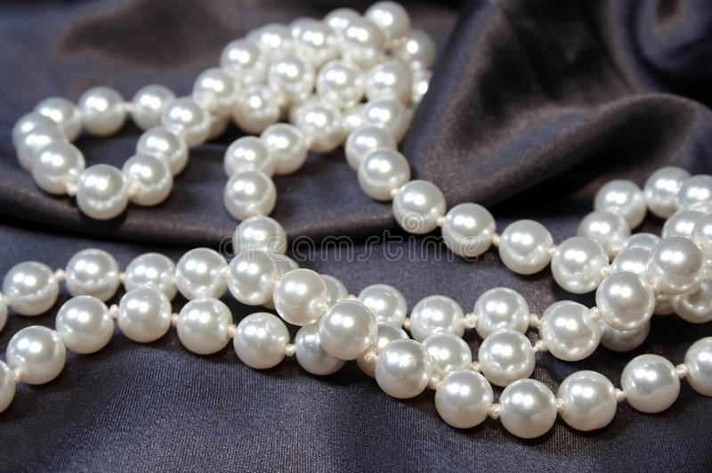
A MAN WITH A PURPOSE
Ask, and it will be given to you; seek, and you will find; knock, and it will be opened to you. ⁸ For everyone who asks receives, and he who seeks finds, and to him who knocks it will be opened. ⁹ Or what man is there among you who, if his son asks for bread, will give him a stone? ¹⁰ Or if he asks for a fish, will he give him a serpent? ¹¹ If you then, being evil, know how to give good gifts to your children, how much more will your Father who is in heaven give good things to those who ask Him! – Matt. 7:7-11

Slide 7
HE HAS THE HIGHEST POSSIBLE PURPOSE
What are my goals and expectations in life?
When we seek and find God we have many promises available to us.

Slide 8
HE IS WILLING TO PAY THE NECESSARY PRICE
And this I pray, that your love may abound still more and more in knowledge and all discernment, ¹⁰ that you may approve the things that are excellent, that you may be sincere and without offense till the day of Christ. Phil. 1:9-10

Slide 9
Do I view my salvation and the Church as a treasure?
What am I searching/looking for in this life?

