Slide 1
What Makes a Good Person?

Slide 2
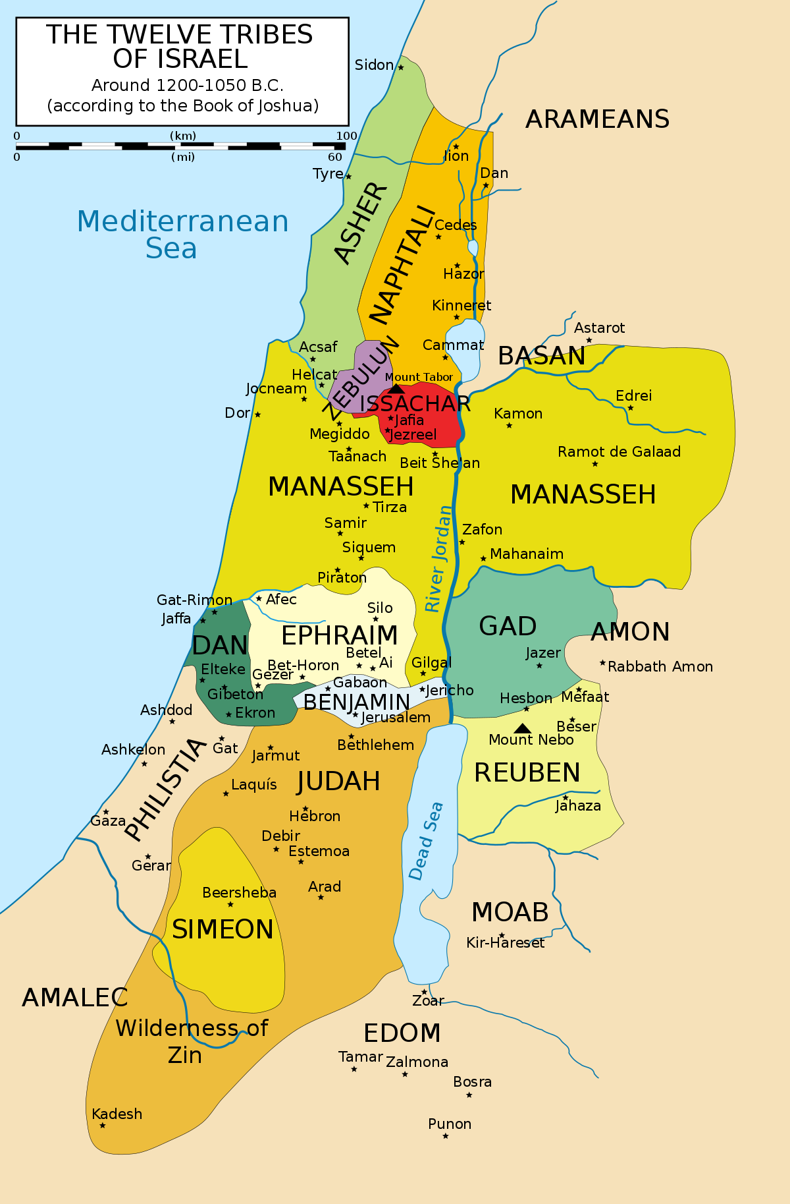
The Problems in Tribal Israel
Leadership
Defense
Communication
Worship

Slide 3
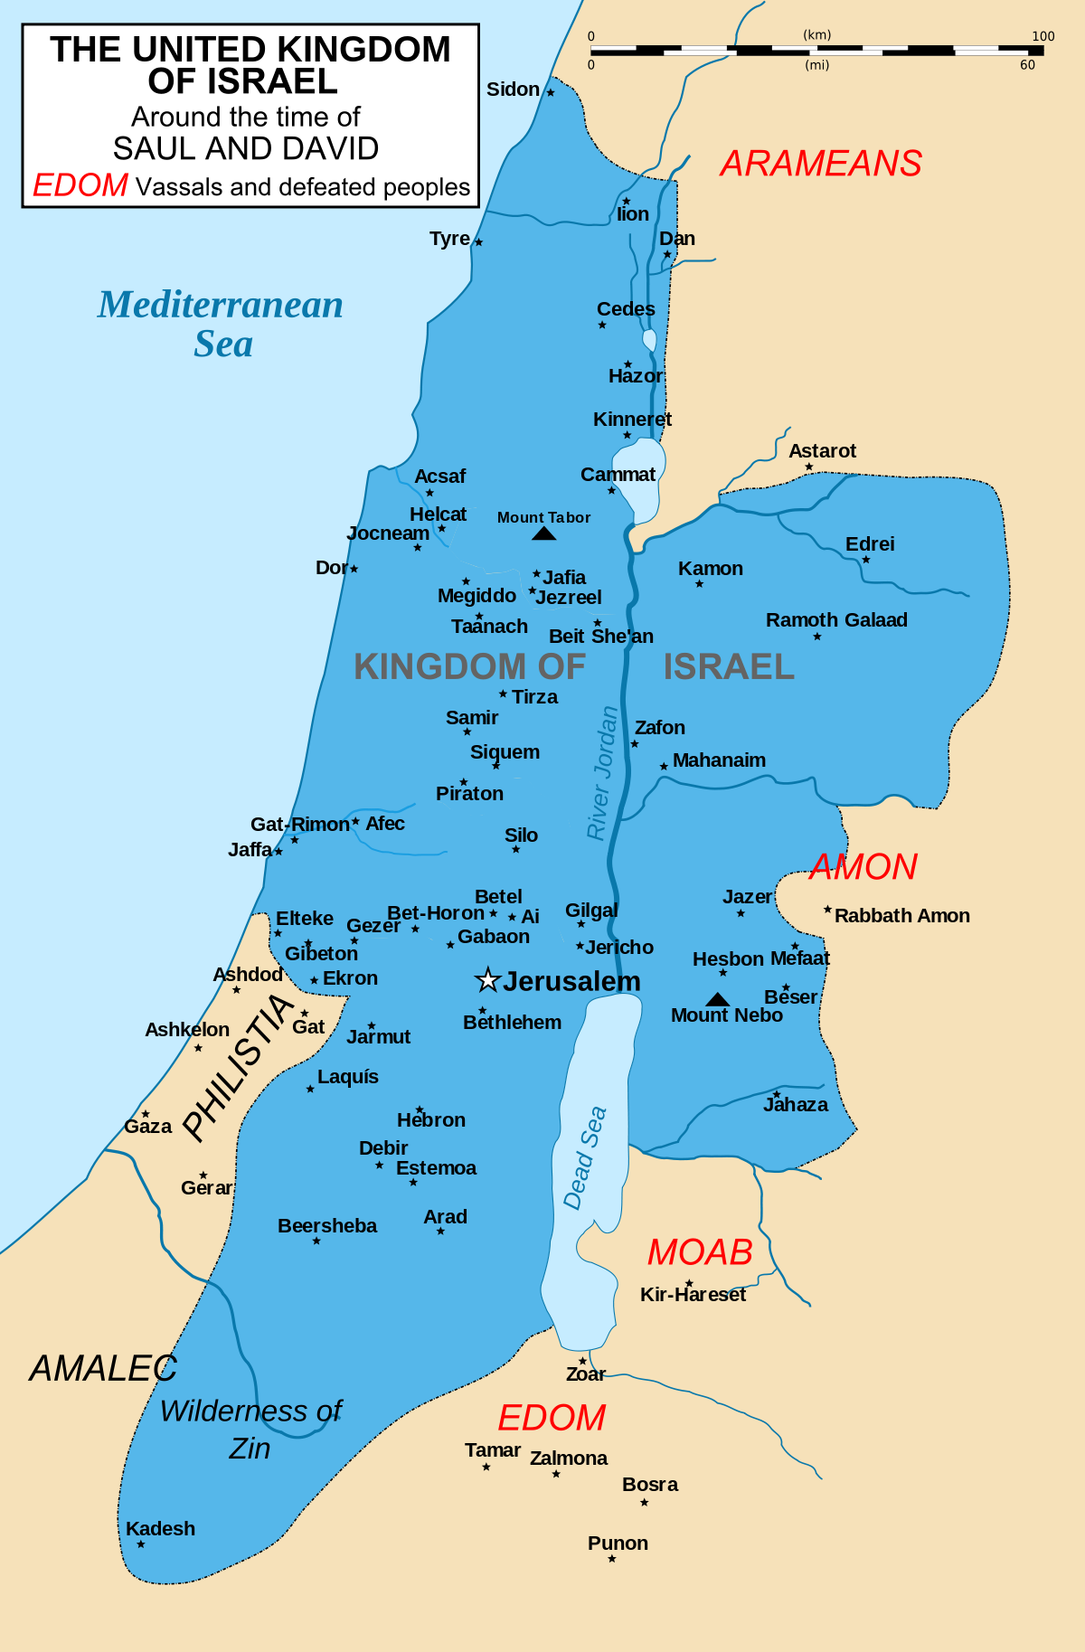
The Kingdom of Israel
Saul Inspired
David Organized
Solomon Enriched

Slide 4
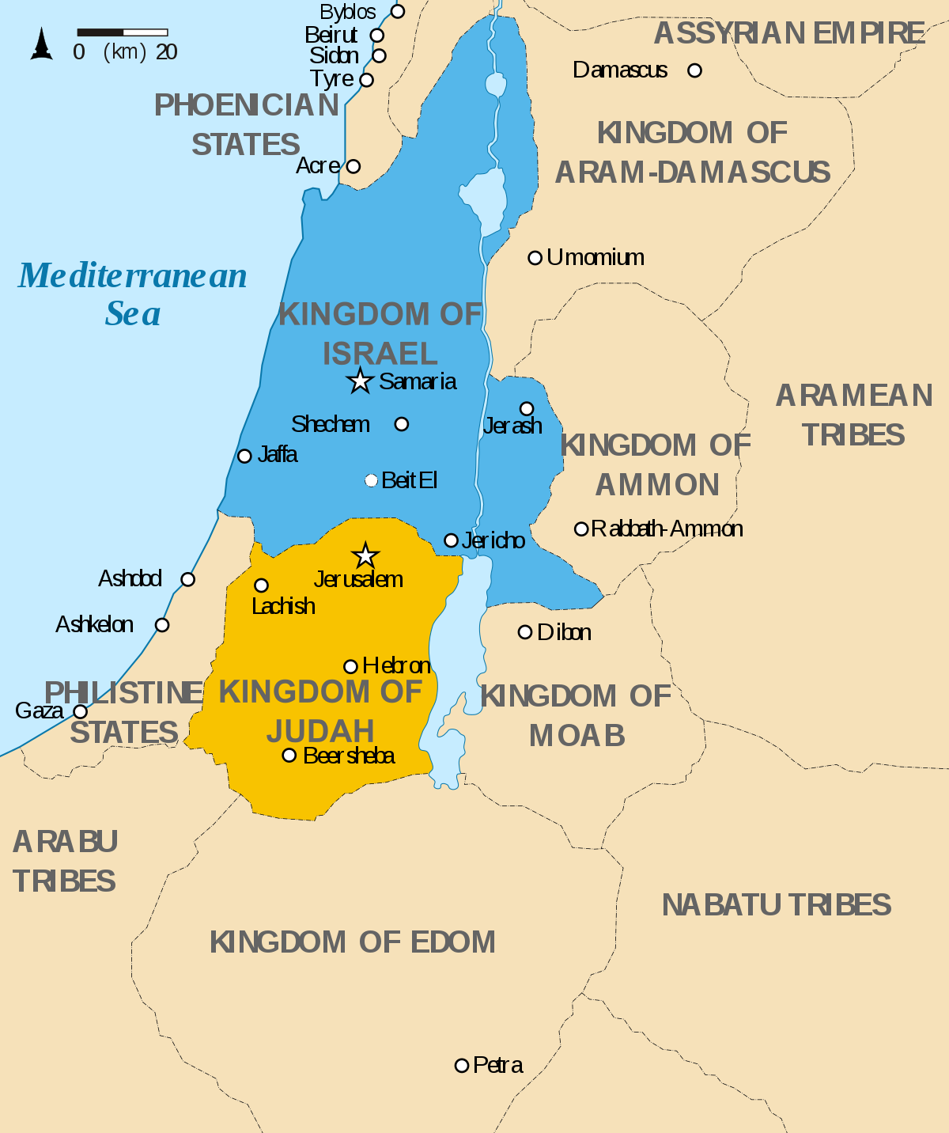
The Divided Kingdom
Jeroboam was given ten tribes due to Solomon’s idolatry
Rehoboam maintained Judah (and Benjamin) because of David
1 Kings 11:26-39

Slide 5
“Asa did what was good and right in the eyes of the LORD his God”
Removed the altars of the foreign gods and the high places
Broke down the sacred pillars and cut down the wooden images
Commanded Judah to seek the LORD and to observe the law and the commandment
Removed the high places and the incense altars from all the cities of Judah

Slide 6
Peace and Quiet
Built fortified cities in Judah
Gave God the glory
Had an army of more than half a million men; all these were mighty men of valor.

Slide 7
The First Million Man March
Zerah the Ethiopian assembles 1,000,000 men against Judah
Asa trusts in God (2 Chr. 14:11)
God defeats and Judah pursues

Slide 8
Continued Progress of Asa
Restoration of Worship
Regained Simeon
Removed mother from position
Dedication to the Temple
“…the heart of Asa was loyal all his days.”
(2 Chr. 15:17)

Slide 9
The Failings of Asa
Treaty with Syria (2 Chr. 16:1-6)
Panic (Matt. 5:25-33)
Be anxious for nothing, but in everything by prayer and supplication, with thanksgiving, let your requests be made known to God; (Philippians 4:6)

Slide 10
The Failings of Asa
Prophet Imprisoned; People Oppressed (2 Chr. 16:10)
Blaming
For we must all appear before the judgment seat of Christ, that each one may receive the things done in the body, according to what he has done, whether good or bad. (2 Corinthians 5:10)

Slide 11
The Failings of Asa
Not consulting God in disease (2 Chr. 16:12)
Foolishness (Ps 14:1)
“…pray without ceasing…”
(1 Thessalonians 5:17)

Slide 12
What Made Asa a Good Person
Did what was Good and Right (2 Chr. 14:2)
Took Courage (2 Chr. 15:8)
Loyal to God (2 Chr. 15:17)

