Slide 1
Elements of the Unknown

Slide 2
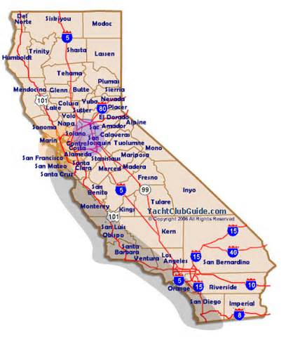
Experts Bold Claims
I cannot conceive of anything more ridiculous, absurd, and more affrontive to all sober judgment than the cry that we are profiting by the acquisition of New Mexico and California. I hold that they are not worth a dollar.
-Senator Daniel Webster 1848

Slide 3
Experts Bold Claims
“No matter what happens, the U. S. Navy is not going to be caught napping.”

Slide 4
Frank Knox
Secretary of the Navy
December 4, 1941
3 Day before Pearl Harbor

Slide 5
There Are Some Things We Cannot Know
Prosperity
Uncertainty of Physical Health
When Our Life Will End

Slide 6
All the Unknown Could Be Very Depressing
Unless we focus on what we do know!
Submit to the Lordship of Jesus and Live for Him

Slide 7
What is Contextual Meaning of He that knows to do good…
In context this is compared to what we do not know…prosperity health length of life
Contrast this to what we can know…God’s Will
Ephesians 5:17 Understanding what the will of the Lord is….contextually….making the best use of the time given

