Slide 1
What’s Up Downstairs?
Growing in Favor with God and man
DANIEL

Slide 2
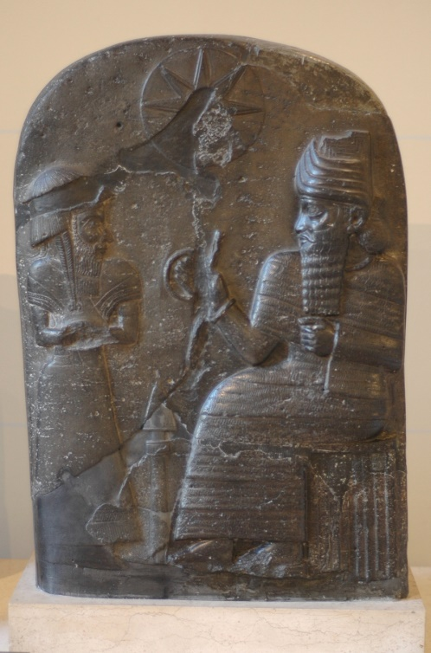
A Brief Look at Daniel
Young Noble
Slave of Two World Powers
Advanced Quickly
Had Enemies (Dan. 6:1-4)

Slide 3
Why the Enemies?
Enemies are Jealous
Enemies are Denied
Enemies are Arrogant
Enemies are Exposed

Slide 4
Satan Tricks Enemies
The “Adversary”
Always Man’s Enemy
Goodness Threatens Satan
Employment of Bullies

Slide 5
Bullies Today
Bullies Back in the Day
Bullies Today
Satan has amplified the Bully Culture
Don’t be a Bully

Slide 6
Overcoming Bullying
Overcome Satan in Christ
Eat your Vegetables!
Follow God’s Commands
Be a Part of the Church

Slide 7
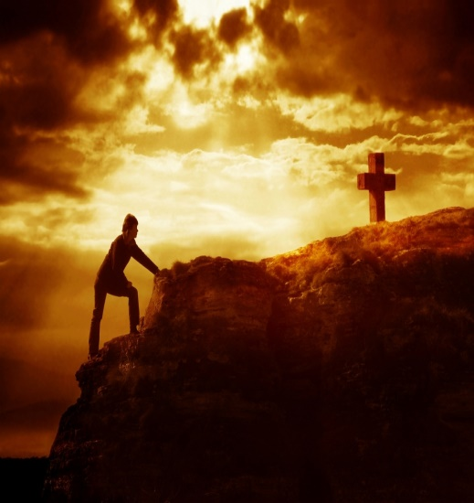
Growing in Favor
Focus on God, Christ, church
Satan is the Enemy
Experience the Power of God

