Slide 1
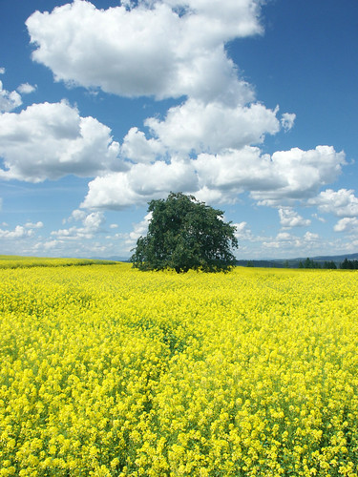
Faith
Your Relationship with Christ

Slide 2
Faith
“…if you have faith as a mustard seed, you will say to a mountain, ‘Move from here to there’ and it will move;” (Matthew 17:20)

Slide 3
Faith
Little Faith
Peter on the Waves
Matthew 14:22-33

Slide 4
Faith
Great Faith
Canaanite Woman
Matthew 15:22-28
Centurion
Luke 7:2-9

Slide 5
Faith
Personal Faith
Moses
Exodus 33:11

Slide 6
Faith
“…if you have faith as a mustard seed, you will say to a mountain, ‘Move from here to there’ and it will move;” (Matthew 17:20)

