Slide 1
Gospel Meeting
Bridgeport WV
I Know The Lord Will Find A Way For Me

Slide 2
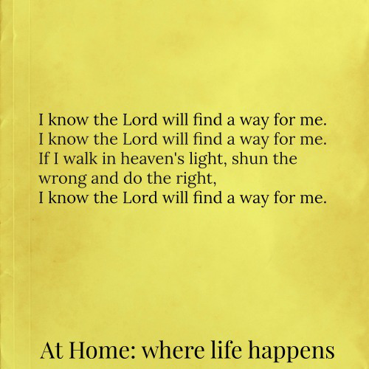

Slide 3
Where Do I Find the Way?
I Peter 3:15
Matt 21:23
The world asks us the same question

Slide 4
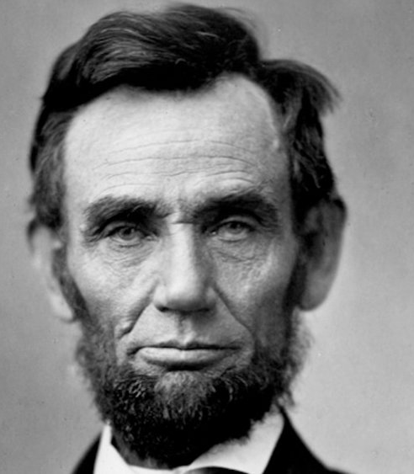
Abraham Lincoln
I believe the Bible is the best gift God has ever given to man. All the good from the Savior of the world is communicated to us through this Book.

Slide 5

Mark Twain
It ain’t the parts of the Bible I can’t understand that bothers me. It’s the parts that I do understand.

Slide 6
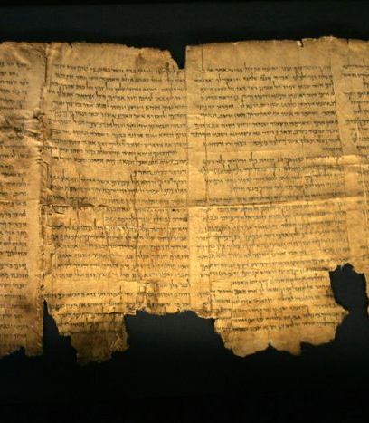
Bible Claims Inspiration
2 Timothy 3:15-17
Dead Sea Scrolls
OT Confirmed 1500 years before Christ

Slide 7

Scientific Foreknowledge
Isaiah 40:22 He sits upon the circle of the Earth
Job 26:7 God hangs the earth upon nothing

Slide 8
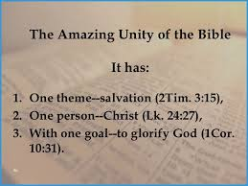
Unity of the Bible
66 Books
1600 years
40 writers
3 Different Languages
Inerrant

Slide 9
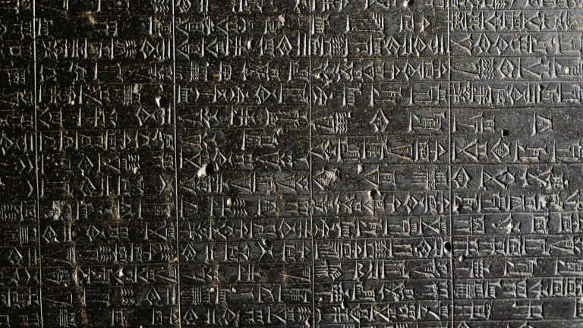
Archaeology
Law Code of Hammurabi
Gen. 14:1 Amraphel
2250 BC
Thousands of years before Moses
Acts 7:22

Slide 10
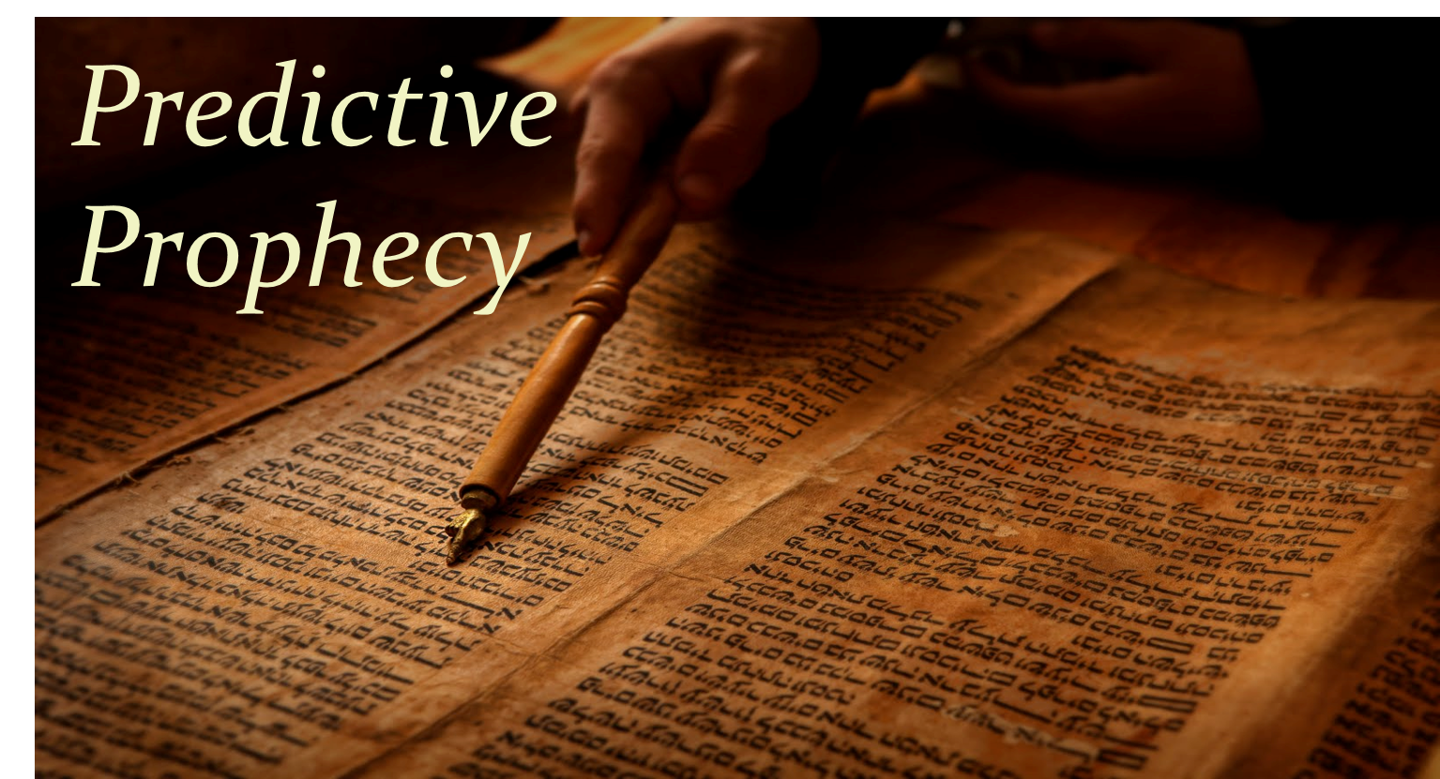
Predictive Prophecy
Psalm 22:12ff
Isaiah 44:28
Isaiah 40:3

Slide 11
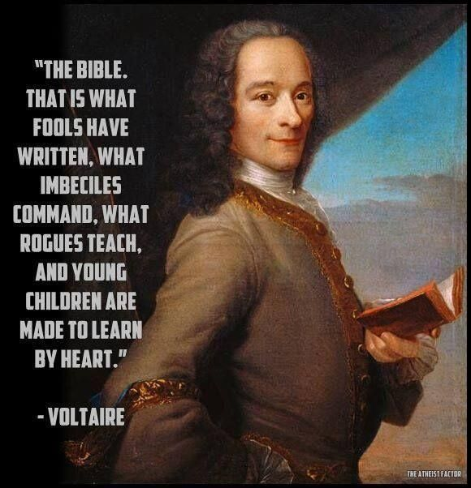
Indestructibility
Voltaire
Within 10 years of my death there will be no Bible
Guess who bought his house?

Slide 12
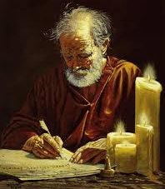
Changes Lives
Peter
Saul
Me
You

