Slide 1
“Behold, I make all things new.”
Revelation 21:5

Slide 2
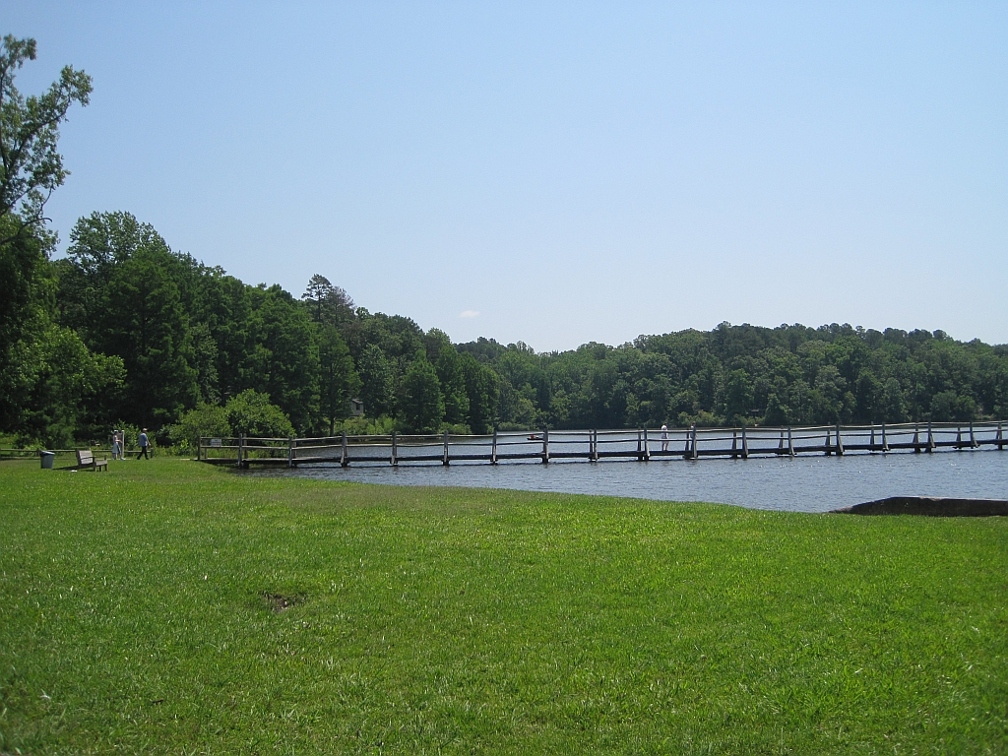

Slide 3
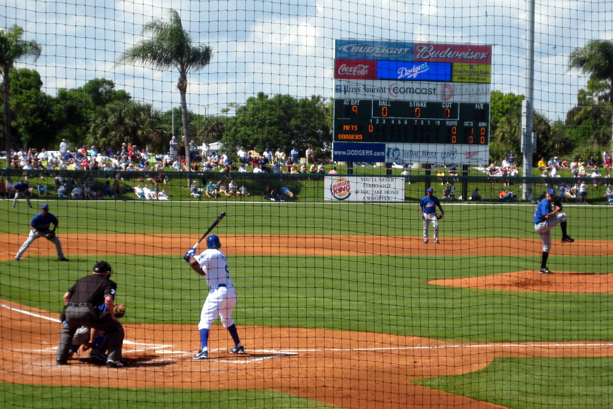

Slide 4
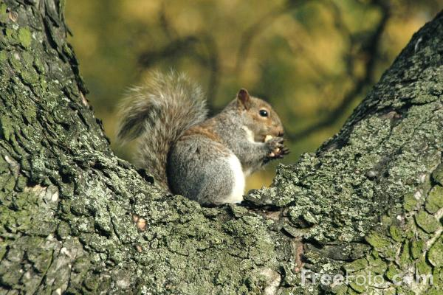

Slide 5
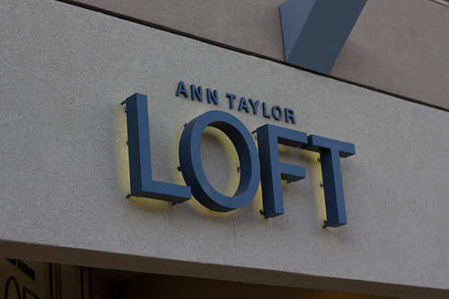

Slide 6
We Tire of the New When…
It becomes Old
It becomes Ordinary
It becomes Obsolete

Slide 7
God Reminds Us…
Remember the New
Proverbs 5:18
Repurpose it New
2 Timothy 2:19-21
Revive and Restore
Isaiah 1:16-18

Slide 8
Our Hope is Always New
God’s Mercies
Lamentations 3:21-24
Our Mind
1 Peter 1:13; Romans 12:1-2
The Eternal Day
2 Peter 3:8; Revelation 22:5

Slide 9
This is the day the LORD has made; We will rejoice and be glad in it.
Psalm 118:24

