Slide 1
Just a cup of cold water

Slide 2
“For whoever gives you a cup of water to drink in My name, because you belong to Christ, assuredly, I say to you, he will by no means lose his reward.” Mark 9:41

Slide 3
It is what we can do
Least
Less
Lone

Slide 4
The Least we can Do
Acknowledges Virtue
Recognition of Virtue
John 12:3
Gratitude of Virtue

Slide 5
The “Lest” we can Do
“Lest we Forget”
Remember the Christian Walk
Matthew 24:40
Daily Reminders

Slide 6
The lone thing we can Do
Sometimes we can only do a small thing
Helping the Overwhelmed
Luke 6:38
God will do great things

Slide 7
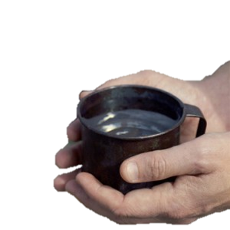
Just a cup of cold water
“For whoever gives you a cup of water to drink in My name, because you belong to Christ, assuredly, I say to you, he will by no means lose his reward.” Mark 9:41

