Slide 1
Everyone thought Job sinned
Job did not sin
Job became distracted while defending himself

Slide 2
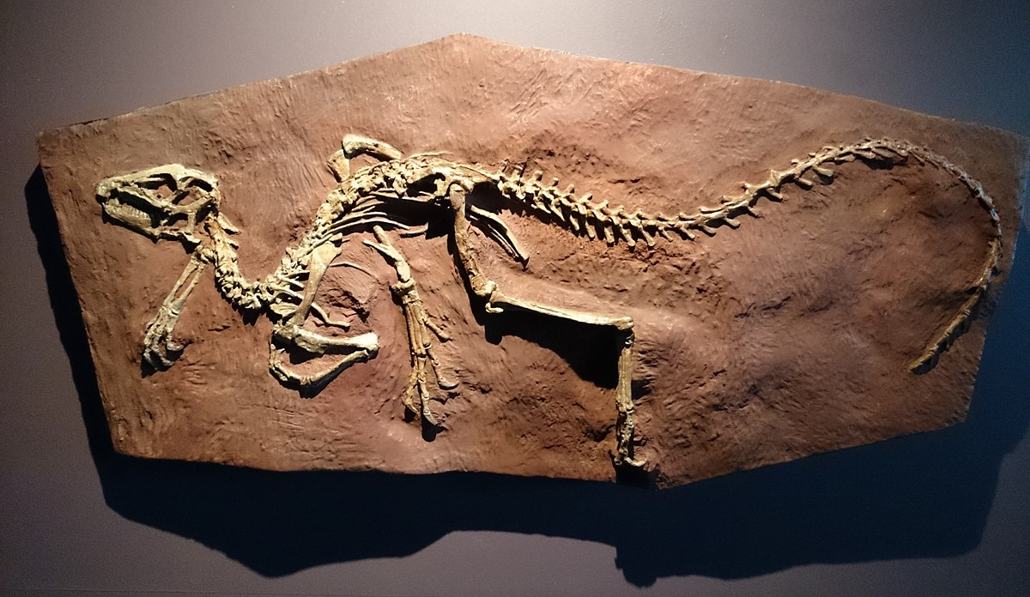
What’s Up Downstairs?
Dinosaurs

Slide 3
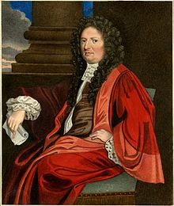
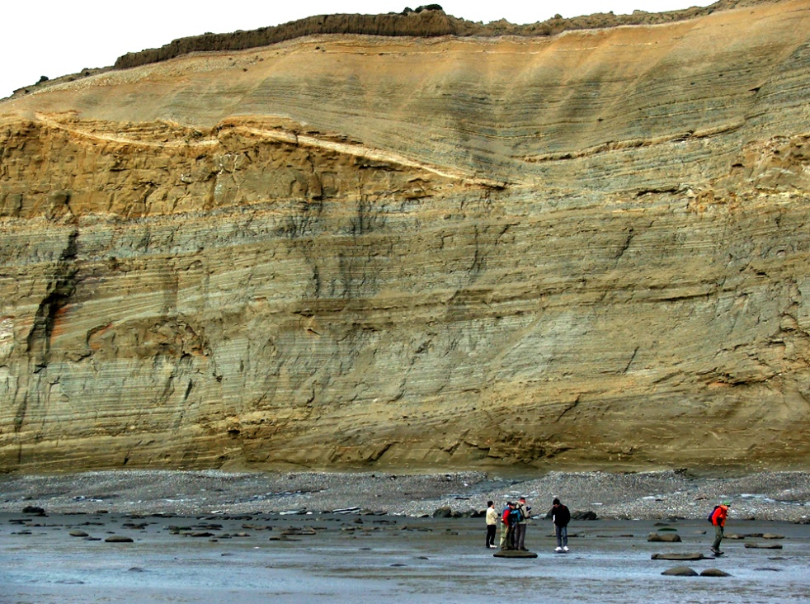
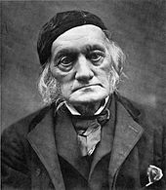
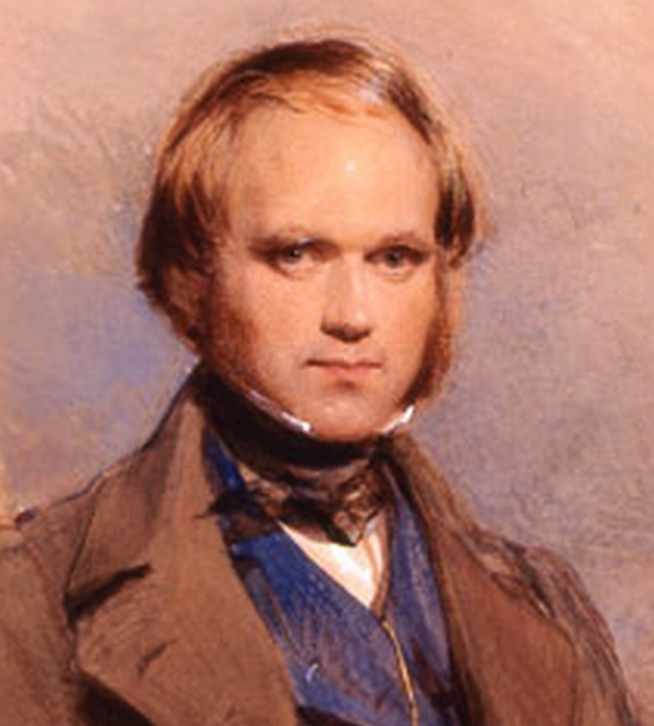
1677
Old
1830
Really Old
Really, Really Old
Really, Really, Really Old
Giant Humans
1842
1859
Theory of Evolution
“DINOSAUR”

Slide 4
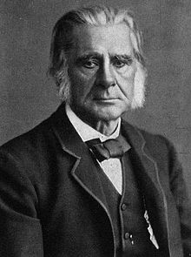
Thomas Huxley (1895-1895)
Darwin’s “Bulldog”
Evolution Only Choice
Fused Evolution with Dinosaurs

Slide 5
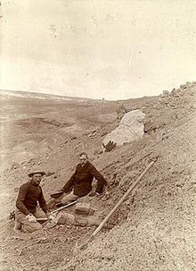
Dinosaur Boom (1920’s)
“Forgotten” Science (1930’s & 40’s)
Dinosaur Renaissance (1975)

Slide 6
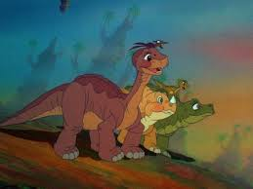
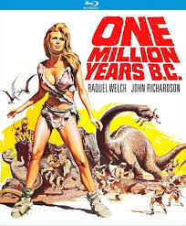
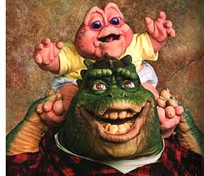
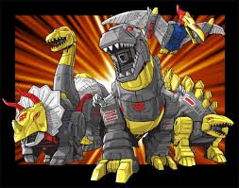
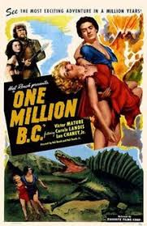
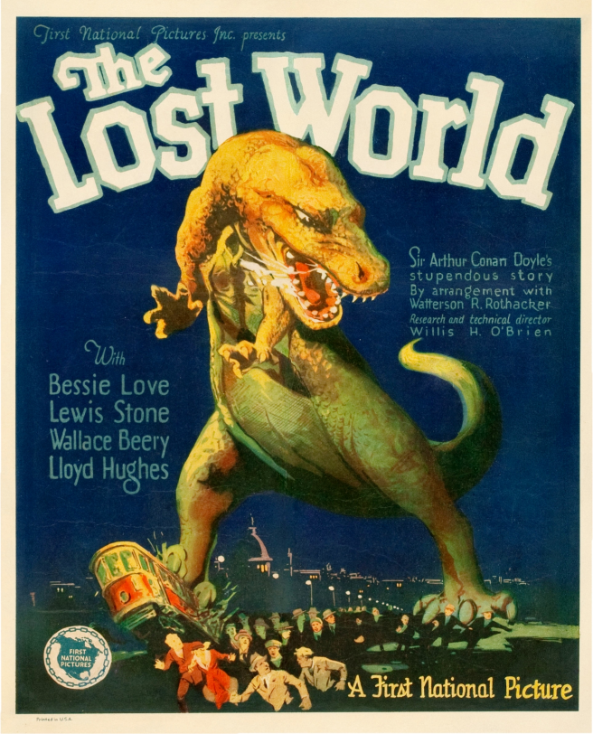
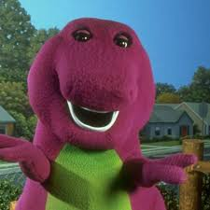
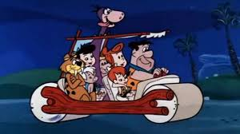
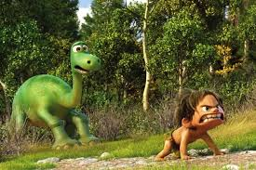
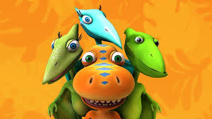

Slide 7
God Replies to Job
Lions and Ravens Job 38:39-41
Wild Goat, Donkey and Ox Job 39:1-12
Ostrich Job 19:13-18
War Horse, Eagle and Hawk 39:19-30
Behemoth and Leviathan Job 40 and 41

Slide 8
“I have heard of You by the hearing of the ear, But now my eye sees You.”
Job 42:5

