Slide 1
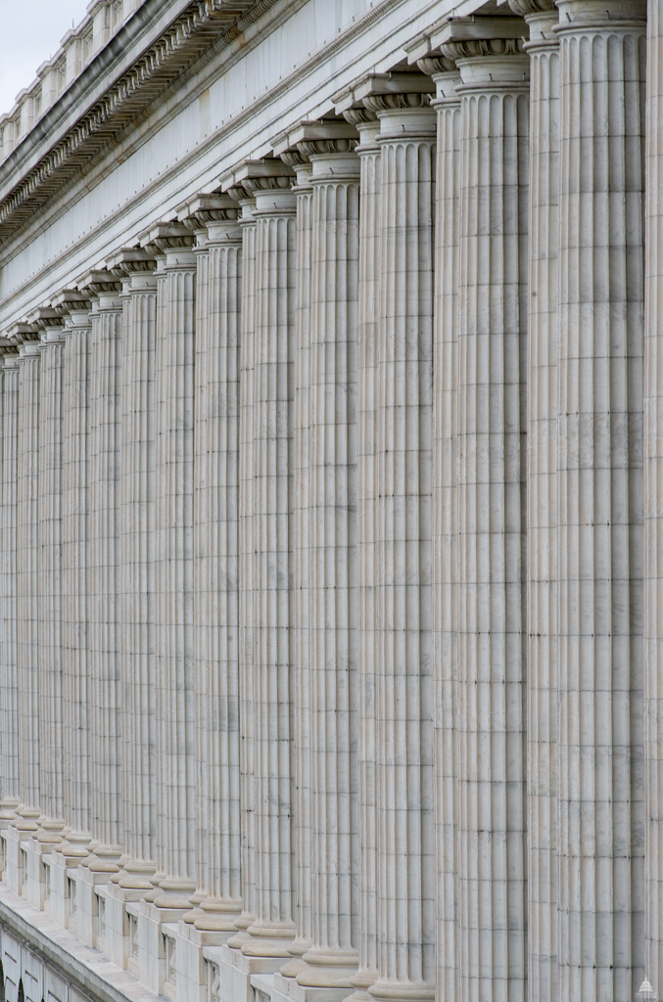
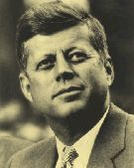
What Can I Do?
BUILD A TEMPLE

Slide 2
Or do you not know that your body is the temple of the Holy Spirit who is in you, whom you have from God, and you are not your own?
1 Corinthians 6:19

Slide 3
God is in Control
God Raised Up Cyrus (2 Chr. 36:22-23)
God Stirred Up Cyrus (Ezra 1:2-4)
God Guided Cyrus (Daniel 6:25-27)

Slide 4
Lead Minds
Repent (Haggai 1:1-5; 2:1-5)
Return (Zechariah 1:1-6)
Restore (Ezra 5:1-2)

Slide 5
Lead Hearts
To Faith (Ezra (4:2-3)
To Christ (Ezra 3:8ff)
To Glorify God (6:15ff)

Slide 6
Lead Souls
By Purity (Ezra 9:1-4)
By Encouragement (Ezra 7:27-28)
By Fear (Malachi 2:16)

Slide 7
What Can I Do?
Or do you not know that your body is the temple of the Holy Spirit who is in you, whom you have from God, and you are not your own?
1 Corinthians 6:19

