Slide 1
The Power of the Lord’s Prayer
Give us this day our daily bread.

Slide 2
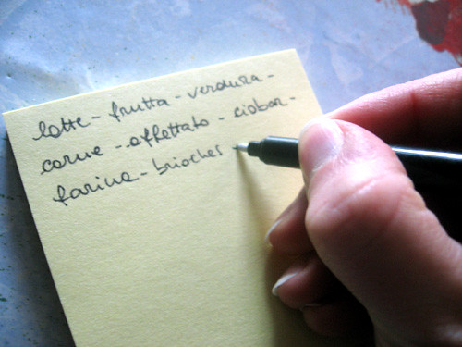
The Grocery List
What do you do with your old lists?
Save them?
Turn them into a book?
You never know.

Slide 3
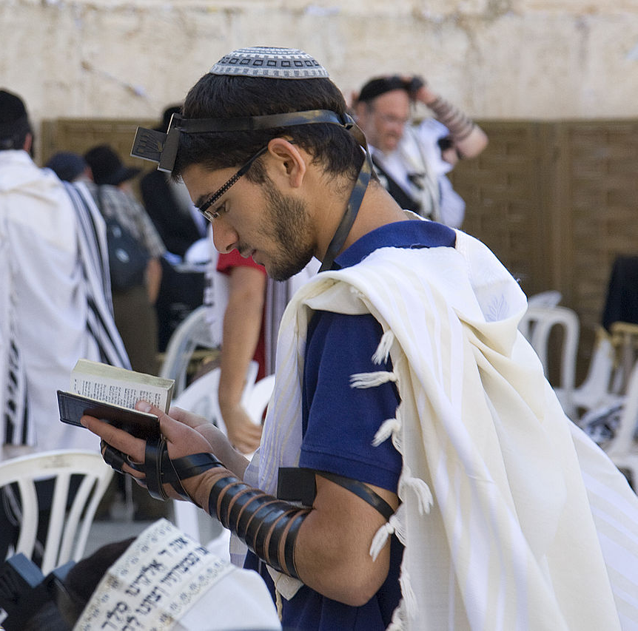
First Century Disciple’s Prayers
Jewish teachers taught prayers consistent with their teachings.
John the Baptist taught such a pray. (Luke 11:1)
Jesus also taught such a prayer.

Slide 4
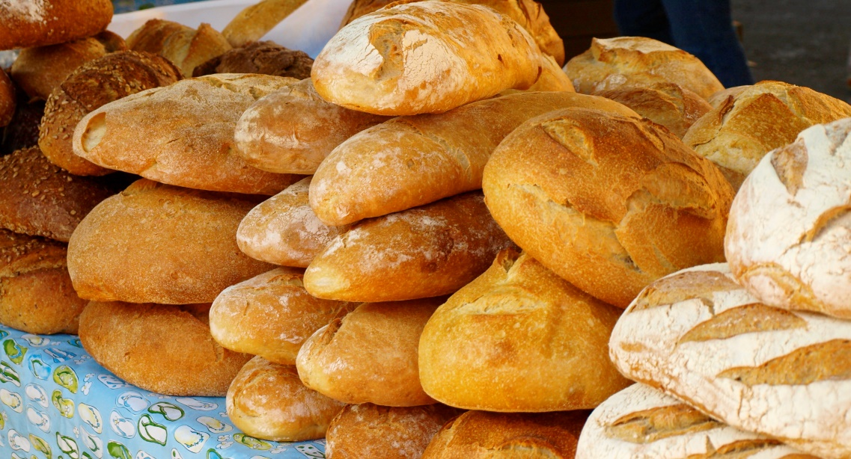
Bread
Bread means Bread!
God is the Creator.
God is the Sustainer.
God Cares.

Slide 5
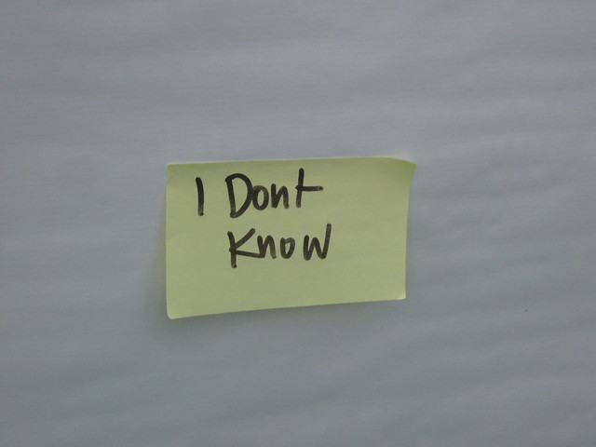
Daily
Not found again in NT.
Not found in any Greek document.
Asking vs. Trusting
Asking God to Help with our daily bread.

Slide 6
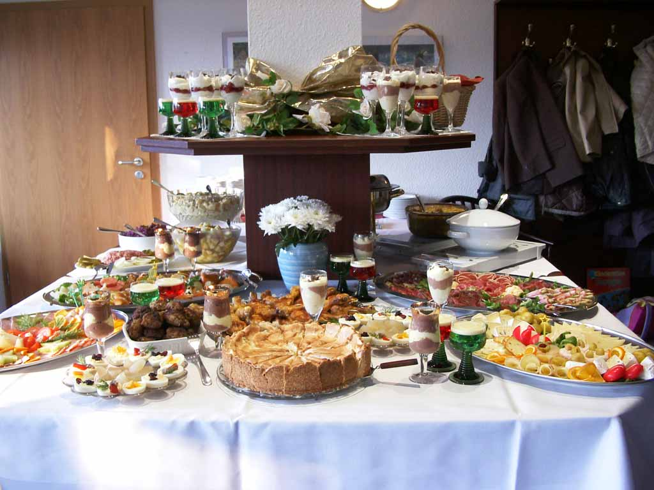
Our
Food for more than one.
The Martha Perspective.
(Luke 10:38-42)
Ask God to help with the meal.

Slide 7
The Power of the Lord’s Prayer
Give us this day our daily bread. (Matthew 6:11)
Give us day by day our daily bread. (Luke 11:3)

