Slide 1
What’s up Downstairs?
Faithfulness

Slide 2
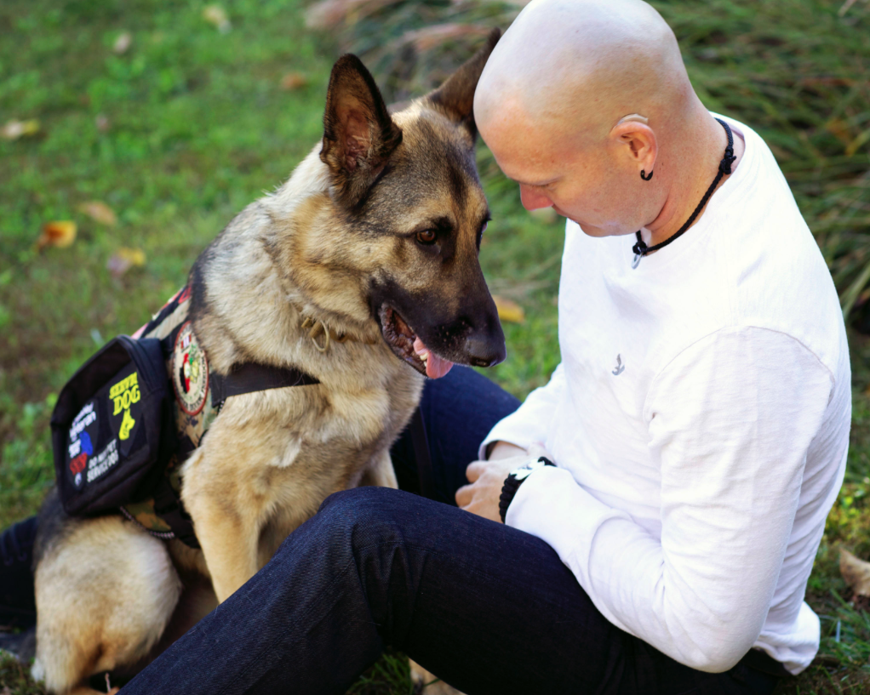
Is Faithfulness and Loyalty the Same?
Service Animals
Peter
Ruth and Naomi

Slide 3
Is Faithfulness and Loyalty the Same?
Loyalty
Faithfulness
"Entreat me not to leave you, Or to turn back from following after you; For wherever you go, I will go; And wherever you lodge, I will lodge; Your people shall be my people, And your God, my God. Where you die, I will die, And there will I be buried. The LORD do so to me, and more also, If anything but death parts you and me."
"All that you say to me I will do."

Slide 4
Am I Faithful If I Sin?
Romans 6:1-2
For He made Him who knew no sin to be sin for us, that we might become the righteousness of God in Him.
2Corinthians 5:21

Slide 5
Am I Faithful If I Sin?
Christians Sin (1 John 1:8)
Christians Do Not Sin (1 John 3:6)

Slide 6
Am I Faithful If I Sin?
…who are kept by the power of God through faith for salvation ready to be revealed in the last time.
1 Peter 3:5

Slide 7
Am I Faithful If I Sin?
We know that whoever is born of God does not sin; but he who has been born of God keeps himself, and the wicked one does not touch him.
1 John 5:18

Slide 8
Am I Faithful If I Sin?
…that the genuineness of your faith, being much more precious than gold that perishes, though it is tested by fire, may be found to praise, honor, and glory at the revelation of Jesus Christ…
1 Peter 1:7

Slide 9
Am I Faithful If I Sin?
Walk in the Light (1 John 1:7)
Confesses your Sin (1 John 1:9)
Remove your Sin (1 John 2:1-2)

Slide 10
Is Faith the Same as Religion?
James 1:26-27
Galatians 2:20
Romans 1:16-17
Jude 3

Slide 11
Am I Faithful?
Are you Obedient to God’s Will?
Are you Walking in the Light?
Do you Live your Faith?
“if you have faith as a mustard seed…nothing will be impossible for you”
Matthew 17:20

