Slide 1
What Must I Do To Be Saved?
Answers Men Give

Slide 2
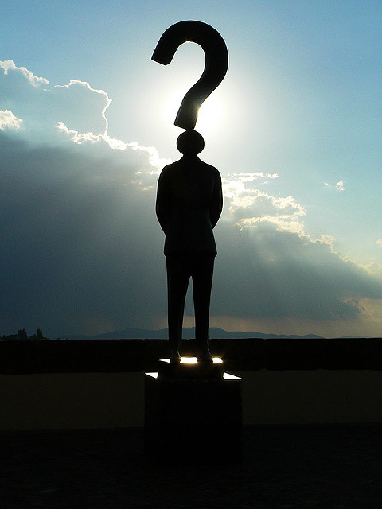
What Must I Do To Be Saved?
Give Money
Don’t Worry About It
Do Nothing
Look For A Sign
Raise Your Hand
Say a Prayer

Slide 3
Acts 2
37 Now when they heard this, they were cut to the heart, and said to Peter and the rest of the apostles, "Men and brethren, what shall we do?"
38 Then Peter said to them, "Repent, and let every one of you be baptized in the name of Jesus Christ for the remission of sins; and you shall receive the gift of the Holy Spirit.

Slide 4
What Must I Do To Be Saved?
What Will You Do?

